Slide 1
MVC Custom Validations
David Turton
Conestoga College
Institute of Technology and Advanced Learning
dturton@conestogac.on.ca
Doon 2A605 x3610

Slide 2
Custom Validation Alternatives
Use [Remote("Action", "Controller")]
To apply validation code you write
Browser calls a server action in the background (AJAX)
… passes the target field
… you can pass other fields from the page
… you can read database tables
… you can return different error messages
Write your own annotations
Derived from the ValidationAttribute abstract class
Server-side only unless you also write the JavaScript
Write a self-validating model
By implementing the IValidatableObject interface
Server-side validation on Bind and on SaveChanges()
The only validation that can modify model properties

Slide 3
[Remote("OrderDateNotFuture", "Remotes")]
[Remote] doesn't fire when user first types into the target field
It fires when user tabs off the field or clicks submit
If the field is invalid, the error message is shown to the user & submit is inhibited
Subsequently, [Remote] executes on each keystroke as the user types corrections
[Remote] will not fire
If the field is unchanged (user didn't type into it) or it is empty/emptied
There's a good side to this …
I used to worry about which controller to use …
Now, I create one controller caller "Remotes" for all [Remote] actions
It's just a suggestion … no magical implications
... "Fred" would work just as well … but will lose marks: meaningful names … remember?

Slide 4
Remote: Additional fields
Occasionally, you have to validate one field against another
Remote allows you to pass additional fields, by name:
The receiving method must expect 3 parameters: target plus 2 additions
With identical names & data types (any order):
This remote action fires when the user types into username
It will not run when firstName and lastName are changed
[Remote("CheckUserName", "Remotes", AdditionalFields = "FirstName, LastName")]
public string UserName { get; set; }
public string FirstName { get; set; }
public string LastName { get; set; }
public JsonResult CheckUserName(string userName, string firstName, string lastName)

Slide 5
Sample Remote Action for userName
/// <summary>
/// userName cannot be derived from firstName or lastName
/// </summary>
/// <param name="userName"></param>
/// <param name="firstName"></param>
/// <param name="lastName"></param>
/// <returns></returns>
public JsonResult CheckUserName(string userName, string firstName, string lastName)
{
userName = userName.ToLower();
if (userName.Contains(firstName.ToLower()) || userName.Contains(lastName.ToLower()))
return Json("userName cannot be derived from user's first or last name");
else
return Json(true);
}

Slide 6
Remote limitations When referencing other fields on the page
The user may not have entered the other fields yet
If input is initially valid …
And user changes a secondary field
Primary field is not re-evaluated
→ because user wasn't typing into the primary field

Slide 7
Remote: does have its uses
Single-field edits:
Corporate-standard pattern checks: postal codes
Validate a foreign-key reference
Ensure not creating duplicates … duplicate key or non-key fields
Differentiates between Edit & Create
[Remote] only fires if the input field is visible, changed and not empty
…so, if the key is already on file, this must be a duplicate Create
Remember:
You don't need to check for nulls
Leave that up to [Required] …
[Remote] won't be called if the user empties or skips the field

Slide 8
Remote uses a Controller Action
So you can't re-use things like a date-check
It's looking for a field named orderDate, not dateOfBirth or dateOfDeath or … you get the idea
What if the action had 5 optional parameters?
Each Nullable<> or a known default value?

Slide 9
Custom Annotations
Annotations you can re-use
These aren't defined for any one model
They can be used by any model
They're methods, not actions
Their parameters aren't name-dependent
Good things to put into a centralised Class Library
For example:
Limit the number of words in a field
Common regular expressions
Date checks … not in future, not in past
IsNumeric, IsInteger, Capitalise, etc.
But they can't change the value of a field: upper/lower/trim, etc.
…the model's Validate method (later) can do that, plus everything an Annotation can.

Slide 10
Create a Class Library
Used to store site-wide or corporate-wide procedures
Can be a project inside this site's solution
Portable, moves with project
Rebuild of whole solution refreshes references
Can be referenced by other projects & solutions
Their change requests may affect your site
Can be a project in a completely separate solution
Add a reference on your projects to the class library's .dll

Slide 11
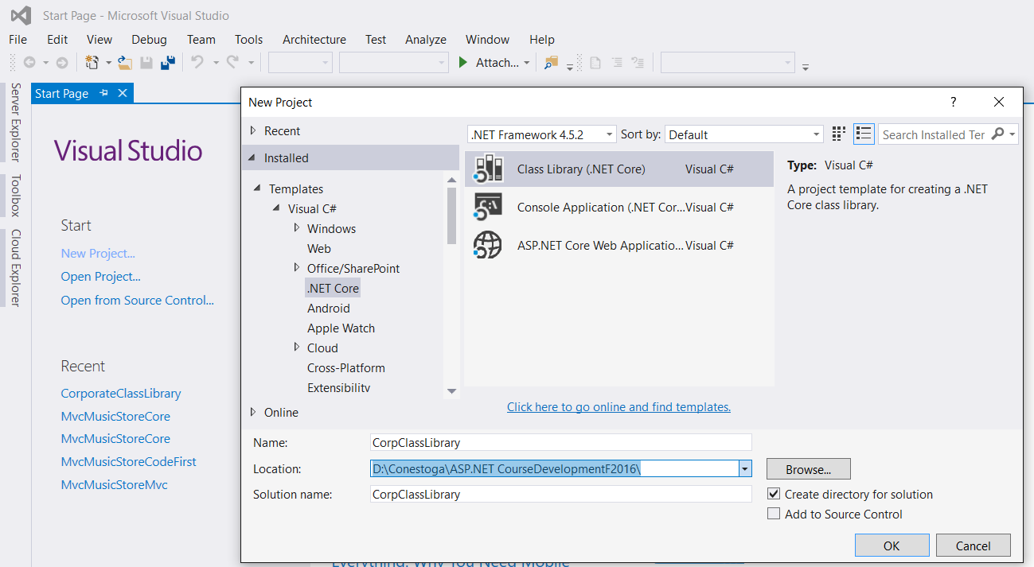
Creating a separate Core Class Library

Slide 12
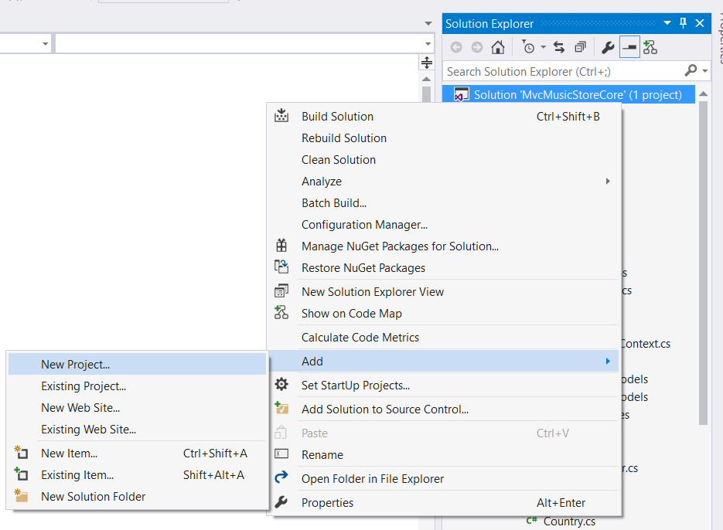
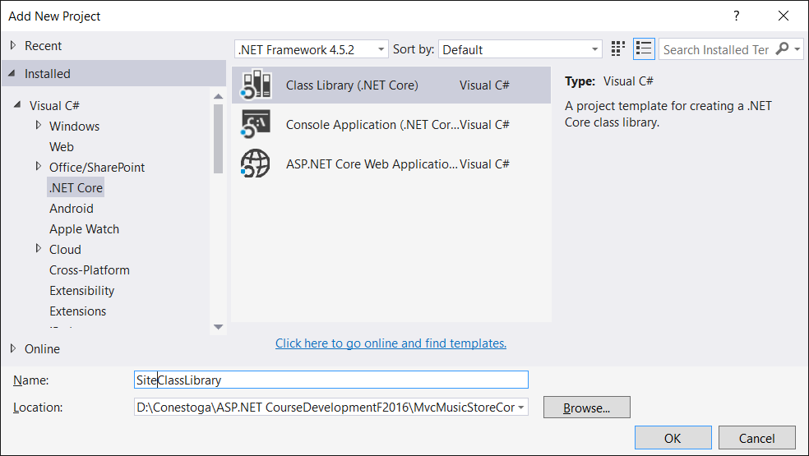
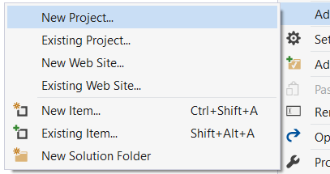
Adding a Core Class Library to Site's solution

Slide 13
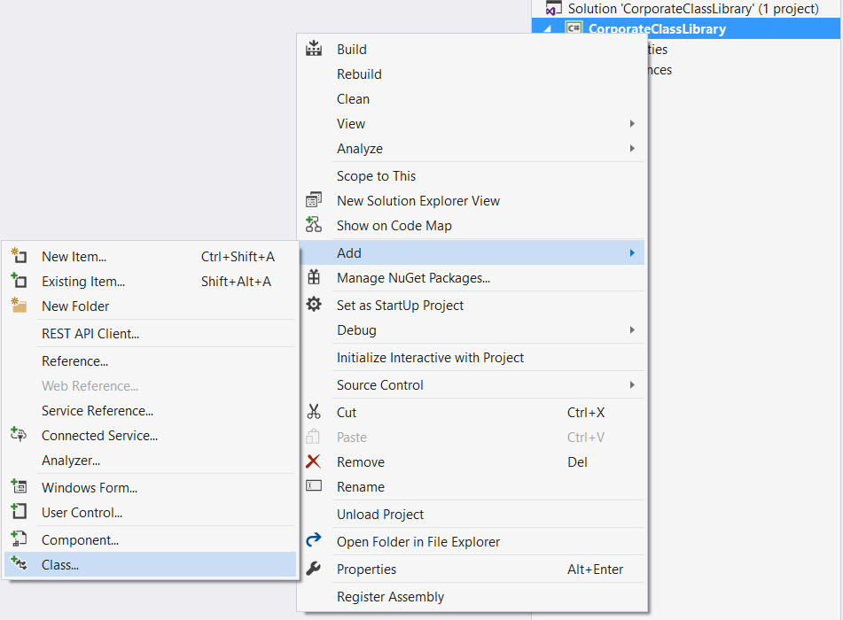
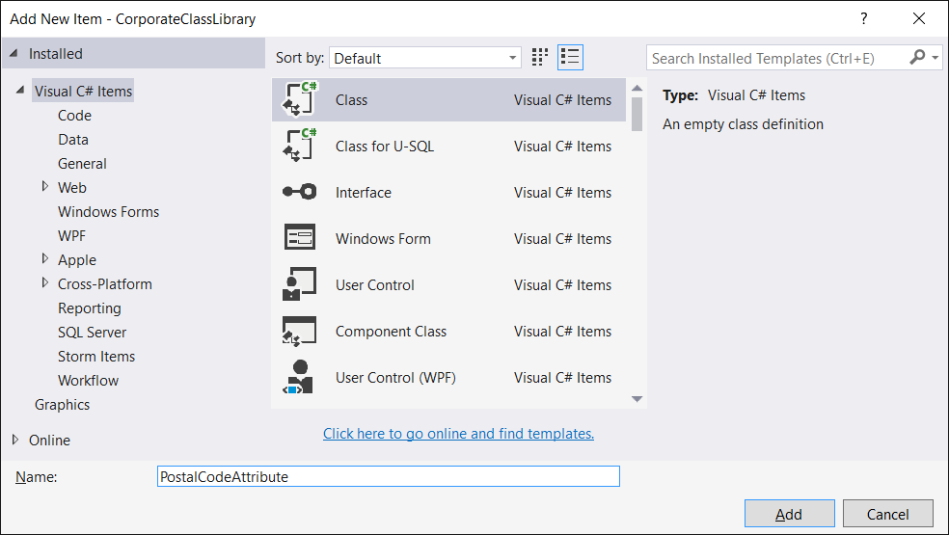
Add new class to Class Library The suffix "Attribute" is not necessary and can be left off in use

Slide 14
Custom Annotation Classes
Inherit from the abstract class:
System.ComponentModel.DataAnnotations.ValidationAttribute
You Override (or re-interpret) its IsValid method
Its parameters provide access to:
The value of the target field and other attributes like:
DisplayName & custom error messages
It returns either:
new ValidationResult("error message");
Which indicates an invalid result & reason
ValidationResult.Success;
Which indicates a valid result

Slide 15
There are 2 IsValid methods …which on should you override in custom annotations?
Just type override in you attribute class
It'll like the methods available to be overridden (or re-interpreted)
Click one … don't type the whole line in
Override the one with 2 parameters:
IsValid(object value, ValidationContext validationContext)
This adds errors to ModelState
You control the error message
Not the one with 1 parameter:
IsValid(object value)
It only returns true or false
It doesn't add errors to ModelState
It doesn't give you control over the message

Slide 16
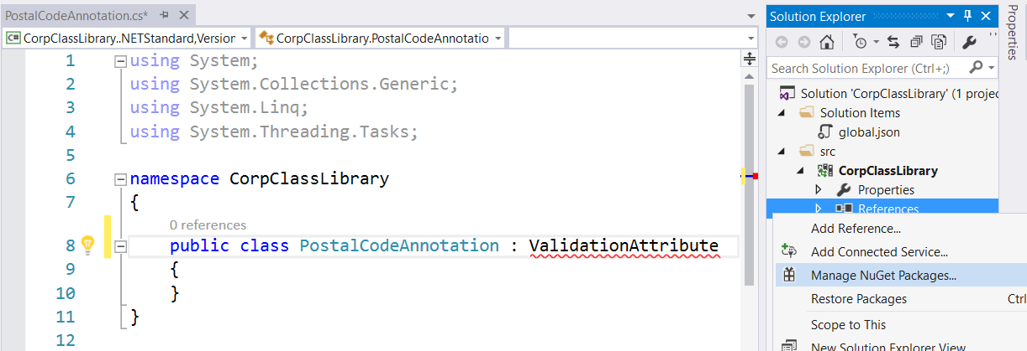
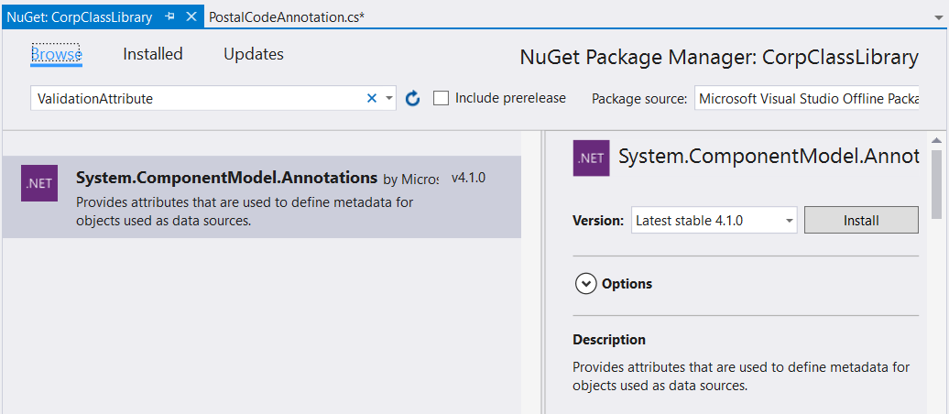
Add namespace containing ValidationAttribute …class libraries are "thin" … don't carry specialised libraries - in Core, these ae added using NuGet

Slide 17
Fill out a postal edit - in some applications, postalCode is optional, so null is OK - if you need it, add [Required]
using System.ComponentModel.DataAnnotations;
using System.Linq;
using System.Text;
using System.Threading.Tasks;
using System.Text.RegularExpressions;
namespace CorpClassLibrary
{
public class PostalCodeAttribute : ValidationAttribute
{
protected override ValidationResult IsValid(object value, ValidationContext validationContext)
{
Regex pattern = new Regex(@"[a-z]\d[a-z] ?\d[a-z]\d", RegexOptions.IgnoreCase);
if(value == null || pattern.IsMatch(value.ToString()))
return ValidationResult.Success;
else
return new ValidationResult(
$"{validationContext.DisplayName} is not a Cdn postal pattern: A3A 3A3");
}
}
}
This is NOT A VALID postal code edit
…not all letters are valid in a postal code
Class libraries should store only rigorous, thorough code
This is easy to write, but not good practice … see WordCountAttribute next page and the reasoning on the following page

Slide 18
Word-Count Validator
public class WordCountAttribute : ValidationAttribute
{
Int32 MaxWords, MinWords = 0;
public WordCountAttribute(Int32 maxWords)
{
ErrorMessage = "{0} cannot be longer than {1} words.";
MaxWords = maxWords;
}
public WordCountAttribute(Int32 maxWords, Int32 minWords)
{
ErrorMessage = "{0} cannot be less than {2} or more than {1} words.";
MaxWords = maxWords;
MinWords = minWords;
}
protected override ValidationResult IsValid(object value, ValidationContext validationContext)
{
if (value != null && (value.ToString().Split(' ').Length > MaxWords ||
value.ToString().Split(' ').Length < MinWords))
return new ValidationResult(
String.Format(ErrorMessage, validationContext.DisplayName, MaxWords, MinWords));
else
return ValidationResult.Success;
}
}
"ErrorMessage" is declared in base class
Two constructors (one parameter or two)
String.Format for messages with multiple parameters

Slide 19
ErrorMessage vs hard-coded message
ErrorMessage is a variable defined in the ValidationAttribute class
Initially null, you give it a value in a constructor
→ Get into the habit of using ErrorMessage, unlike PostalCodeAttribute
Why?
Programmers may want to replace or translate your message:
[WordCount(5, 2, ErrorMessage ="{0} must be between {1} and {2}, inclusive")]
[WordCount(5, 2, ErrorMessageResourceName="BetweenXandXX",
ErrorMessageResourceType=typeof(Translations))]
public string City { get; set; }
These messages will replace the value your constructor places into ErrorMessage
But not the hard-coded one I used in PostalCodeAttribute
or

Slide 20
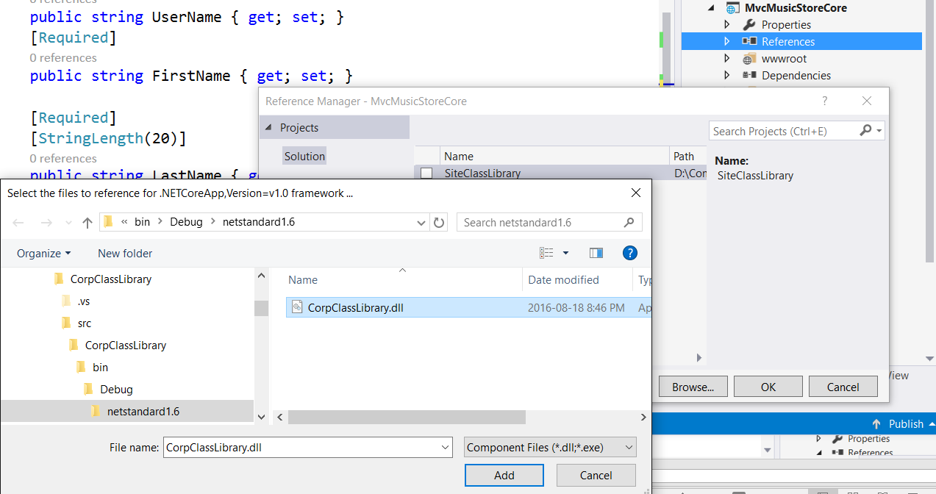
Back at Web Site: Add a Reference to your Class Library …well, to its compiled .dll … here, I'm using its debug version
Add Reference
Local class library
Remote class library

Slide 21
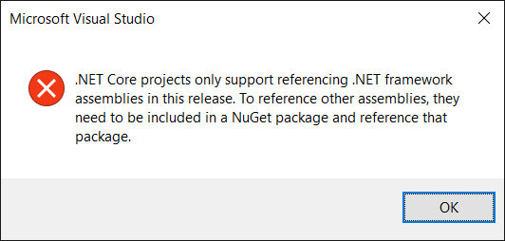
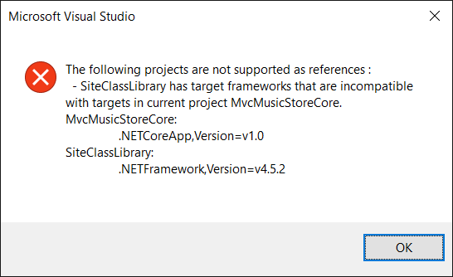
Huh … new wrinkles
.NET Core projects
Don't like Class Libraries based on .NET Framework
Pity corporations with large libraries of code.
This is why you need to pick the Core Class Library

Slide 22
Applying Custom Annotations - model needs a "using" reference to the class library
[WordCount(5, 2)]
public string City { get; set; }
[Display(Name = "Province")]
public string ProvinceCode { get; set; }
[PostalCodeAttribute]
public string PostalCode { get; set; }
The "Attribute" extension to the class file-name is not necessary when referencing them
Still, it's good practice to have it when creating them

Slide 23
Custom Annotations Normally: let null pass
Only [Required] checks for null and spaces
Other validators usually don't look for these
At least not on the client-side
Also, most validators only execute as the user types into a field
If left empty, checks won't be done until page is submitted
Custom annotations run on server
So they do see nulls and empty strings
They should pass these as acceptable…
So an application where the field is optional can use the one routine.
If it's not optional, just add [Required]
I don't think they should accept spaces, though

Slide 24
Self-Validating Model
Implementing the interface:
IValidatableObject

Slide 25
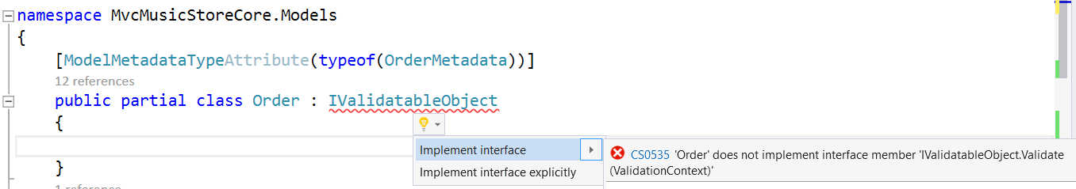
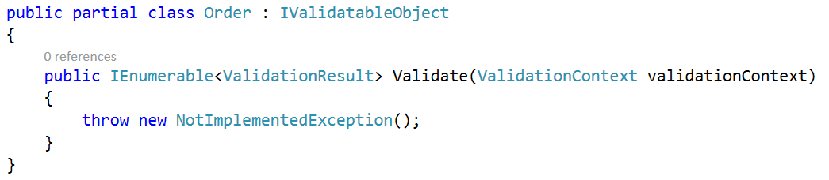
IValidatableObject
A model that knows how to validate itself
Have the partial class implement the IValidatableObject interface
Keep the generated model "clean"
Right-click & "implement" this interface:
Don't leave this in … change it to this:
yield return ValidationResult.Success;

Slide 26
Self-Validating Models
Binder & SaveChanges() call the "Validate" method for you.
… if you specified IValidatableObject, to tell them it's there
Return-type and parameters are different
Returns a collection of returned ValidationResult objects
It validates the whole model, collecting all errors found
No data parameters are passed to Validate
It's an instance method inside the object: object's properties are local to it
It's an Edit method, firing after all fields have been input
You can cross-validate fields
You can trim spaces off strings, shift to upper case
You can check for nulls
You can validate using database lookups

Slide 27
Self-Validating Models & Annotations
You can still use custom validation annotations
These will be checked on the client side
… unless you write the jQuery for them
Validate method
Purely server-side validation
Premise: it needs the whole model
ModelState error-display works seamlessly with it
ValidationResult output goes straight to ModelState
View code is unchanged
Controller code is unchanged

Slide 28
Self-Validating Example
public IEnumerable<ValidationResult> Validate(ValidationContext validationContext)
{
if (FirstName == null || FirstName.Trim() == "")
yield return new ValidationResult("First name cannot be empty or just blanks",
new[] { "FirstName" });
else FirstName = FirstName.Trim();
if (UserName == null || UserName.Trim() == "")
yield return new ValidationResult("User Name cannot be empty or just blanks",
new[] { "UserName" });
else
if (FirstName != null && UserName.Contains(FirstName))
yield return new ValidationResult("User Name cannot be derived from First Name",
new[] { "UserName", "FirstName" });
}
2nd parameter is an array of the fields that will show the error message

Slide 29
Ummm … .NET Core 1.0 is "incomplete"
Use:
<div asp-validation-summary="All" class="text-danger"></div>
Server-side field errors do not show beside the field on the Views
…these are ModelState errors set by:
ModelState.AddModelError("FirstName", "First Name cannot be empty ");
yield return new ValidationResult("First Name cannot be empty",
new[] { "FirstName" });
However, the HTML Helper still works:
@Html.ValidationMessageFor(a => a.FirstName)
Instead of:
<span asp-validation-for="FirstName" class="text-danger" />

Slide 30
Annotations and self-validating Models
A self-validating model can have field annotations as well
Just appreciate which runs when.
Error check-and-display code are the same for both, in controller & view
Annotations from Microsoft run on the client (browser)
Reducing invalid traffic to the server
[Remote] runs on the server, while user is typing on the page
Providing real-time feedback to the client
And inhibiting invalid traffic to the server
Custom annotations & the Validate method on the model
Run when the page is submitted to the server
…and the Validate code can be much more comprehensive

